Slide 1
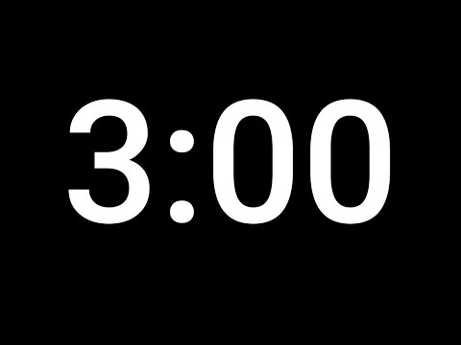
Check out this project: （藏猫猫）
What aspects of the project do you know how to create today?
What parts of this project are you not confident in creating today?
How would you change this project to make it better or your own?

Slide 2
Unit 5 Project Celebration!
What was your favorite part of this project?
What was most challenging about it?
SHARE LINK & IMAGE OF STUDENT PROJECT HERE

Slide 3
use jQuery to select（选择）, show（显示）, and hide（隐藏） HTML elements.
Vocabulary: jQuery, action, selector, .show(), .hide()
Notes:
Coders should read aloud the objective.

Slide 4
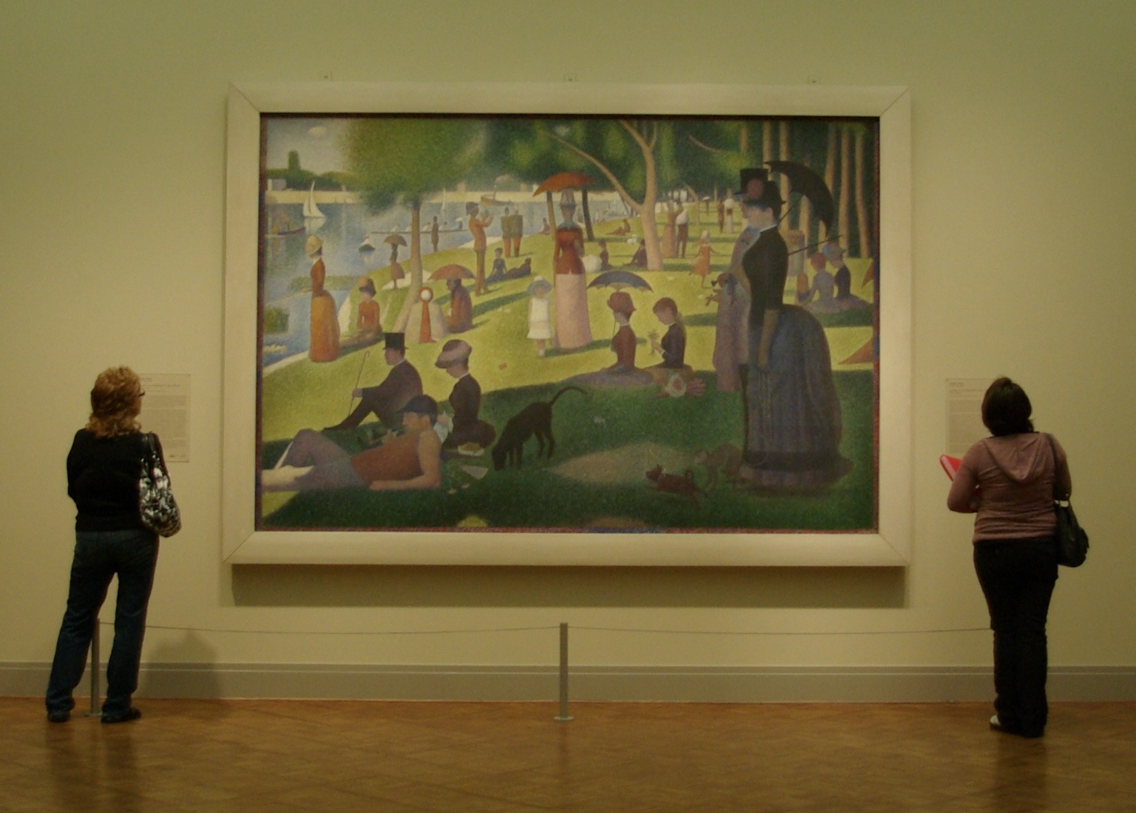
Interactive（交互式） websites
We know how to make websites that look cool using HTML and CSS, but they don’t do anything yet.

Slide 5
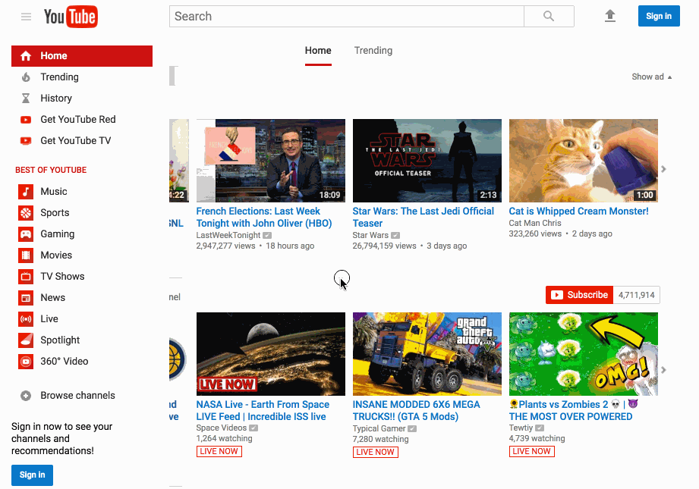
Interactive websites
Our favorite websites are interactive.
What do we mean by this?

Slide 6
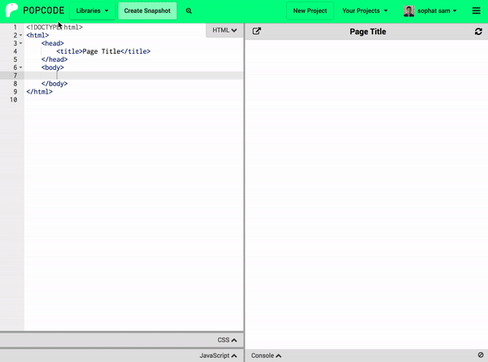
With the person next to you, list all the ways that Popcode does something in response to what you do.

Slide 7
The Popcode menu
Let’s break down the logic of what we experience on Popcode:
When the user clicks on a menu item, a dropdown of options appear.
This is a very common kind of logic! We call it a click handler.
Notes:
Here you should particularly emphasize the two main “pieces” of the click handler logic, corresponding to the two lines of bold text written on the slide.

Slide 8
What is jQuery?
We will use jQuery to make our websites interactive!
jQuery is a Javascript library (we will learn more about libraries later)
Think of it as a book of magic spells to add functionality to your website
Make things disappear（消失）
Make things appear（出现）
Change an image or text （改变）

Slide 9
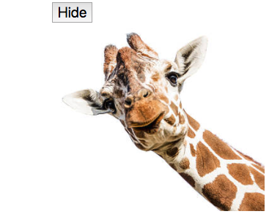
jQuery in Action
When someone clicks（点击） any button （按钮）element, hide （隐藏）the img elements.
<button>Hide</button>
<img src="giraffe.jpg">
Notes:
Run through this and the next slide quickly, we will go into more detail on each part in later lessons
Quick Popcode example: https://popcode.org/?snapshot=1e5a673d-048a-4a9d-a021-ae9a91b34216

Slide 10
jQuery in Action
<button>Hide</button>
<img src="giraffe.jpg">
Plain English
When a button （按钮）element is clicked（点击）, hide （隐藏）the img （图像）elements.
jQuery
$("button").click(function() {
$("img").hide();
});
Notes:
The first time the students are seeing actual JavaScript/jQuery code. Note that you don’t need to break everything down here—the subsequent slides will take care of that. The point to emphasize here is that the English on the left and the jQuery on the right are saying the exact same thing.

Slide 11
jQuery in Action
<button>Hide</button>
<img src="giraffe.jpg">
jQuery
Plain English
When someone clicks any button element,
hide the img elements.
$("button").click(function() {
$("img").hide();
});
Notes:
Now we’re starting to break it down. Point out that the English version breaks down into two thoughts—first, when something should happen; second, what should happen.

Slide 12
jQuery in Action
<button>Hide</button>
<img src="giraffe.jpg">
jQuery
Plain English
When a button element is clicked,
hide the img elements.
$("button").click(function() {
$("img").hide();
});
Notes:
Now we’re starting to break it down. Point out that the English version breaks down into two thoughts—first, when something should happen; second, what should happen.

Slide 13
jQuery in Action
<button>Hide</button>
<img src="giraffe.jpg">
jQuery
Plain English
When a button element is clicked,
hide the img elements.
$("button").click(function() {
$("img").hide();
});

Slide 14
jQuery in Action
<button>Hide</button>
<img src="giraffe.jpg">
jQuery
Plain English
When a button element is clicked,
hide the img elements.
$("button").click(function() {
$("img").hide();
});
Notes:
The first time the students are seeing actual JavaScript/jQuery code. Note that you don’t need to break everything down here—the subsequent slides will take care of that. The point to emphasize here is that the English on the left and the jQuery on the right are saying the exact same thing.

Slide 15
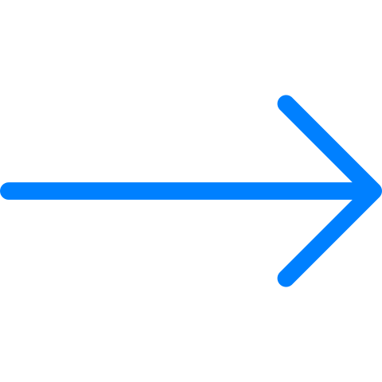
Breaking it down: jQuery
to use jQuery, you must always start with a $ sign
jQuery
$("button").click(function() {
$("img").hide();
});
Notes:
Include a brief explanation that “The dollar sign signals to the computer that you will be writing jQuery code”

Slide 16
The Selector （选择器） selects the HTML element
Selector
$("button").click(function() {
$("img").hide();
});
Notes:
Emphasize the difference btwn the two selectors -- one is receiving and action and one is the receiving an action. One element is the target of the click event and one element is acted upon in the body. Don’t go too deep into events and click handlers as that will be covered in later lessons.

Slide 17
The event （事件） is what the user does to the selector
event
$("button").click(function() {
$("img").hide();
});
Notes:
Emphasize the difference between the event and the action—the event is something we are waiting for the user of our webpage to do. The action is what we tell the page to do.

Slide 18
The action（动作） is what the website does in response to the event
$("button").click(function() {
$("img").hide();
});
action
Notes:
Emphasize the difference between the event and the action—the event is something we are waiting for the user of our webpage to do. The action is what we tell the page to do.

Slide 19
Besides HTML tag（标签） names, what else can you use as a selector?
Besides HTML tag names, what else can you use as a selector?
Selector
$("button").click(function() {
$("img").hide();
});
Notes:
Emphasize the difference btwn the two selectors -- one is receiving and action and one is the receiving an action. One element is the target of the click event and one element is acted upon in the body. Don’t go too deep into events and click handlers as that will be covered in later lessons.

Slide 20
Selector （CSS class选择器）
Selector
$(".hidePuppy").click(function() {
$(".puppyPic").hide();
});
Notes:
Emphasize that this is the same selectors as CSS…. use . for class

Slide 21
Class Selector
Class Selector
$(".hidePuppy").click(function() {
$(".puppyPic").hide();
});
Notes:
Emphasize that this is the same selectors as CSS…. use . for class

Slide 22
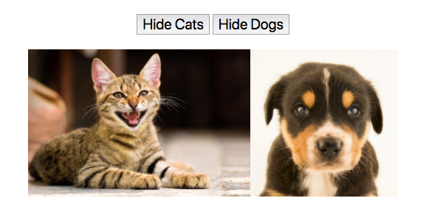
What will happen on the page when a user clicks a button?
$("button").click(function() {
$("img").hide();
});
<button>Hide Cats</button>
<button>Hide Dogs</button>
<img src="cats.jpg">
<img src="dogs.jpg">
中文版：
https://popcode.org/?snapshot=092a95a1-b50a-4a05-bd34-328b0244af8a
Notes:
Probe students to be specific -- when the user clicks which button? Which image(s) will hide?

Slide 23
How do we hide only the cat image when the Hide Cats button is clicked?
<button>Hide Cats</button>
<button>Hide Dogs</button>
<img src="cats.jpg">
<img src="dogs.jpg">
Notes:
How do we affect some HTML tags but not others?

Slide 24
We need to give each button and image a class so we can select them.
<button class=“hideCats">Hide Cats</button>
<button class="hideDogs">Hide Dogs</button>
<img class="catPic" src="cats.jpg">
<img class="dogPic" src="dogs.jpg">
Notes:
How do we affect some HTML tags but not others?

Slide 25
Now we can select the specific button with jQuery.
$(".hideCats").click(function() {
$(".catPic").hide();
});
<button class="hideCats">Hide Cats</button>
<button class="hideDogs">Hide Dogs</button>
<img class="catPic" src="cats.jpg">
<img class="dogPic" src="dogs.jpg">
Notes:
How do we affect some HTML tags but not others?

Slide 26
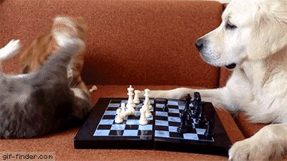
Let's see who wins: Cats vs Dogs!
We need to use jQuery to hide the correct image when the buttons are clicked.
Notes:
This is the first time students will be writing in the Javascript pane. Call this out explicitly and identify that jQuery belongs in Javascript.

Slide 27
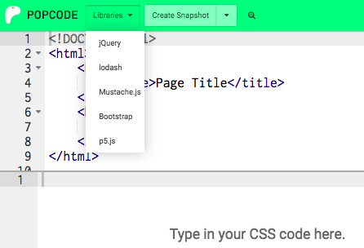
Enable jQuery!
Remember to enable (turn on) jQuery in Popcode!

Slide 28
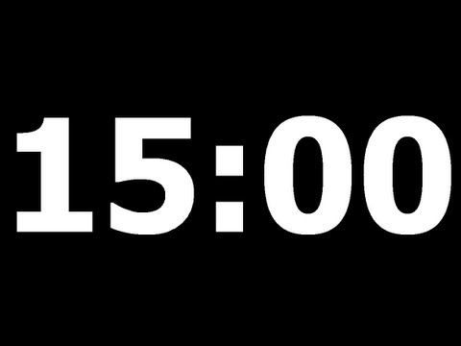
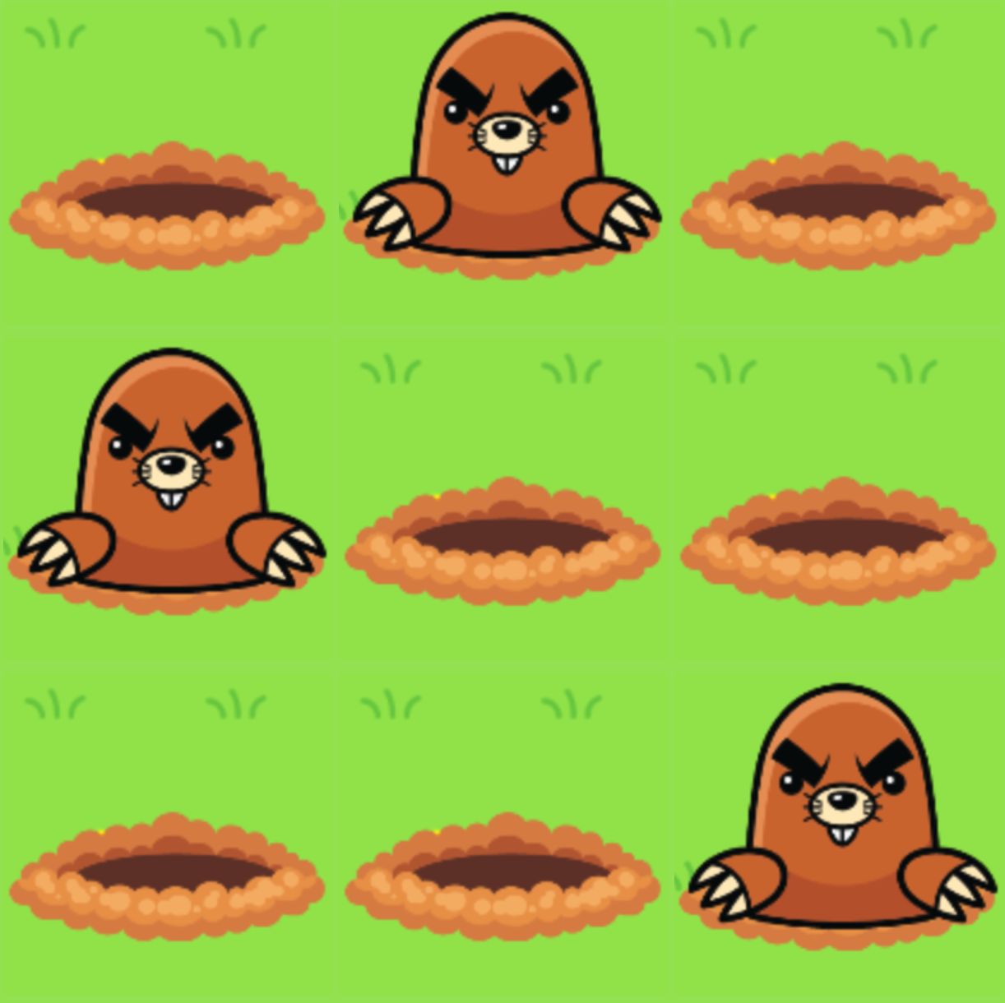
Whack（重击）-a-mole（鼹鼠）! Our yard is infested with moles and we need to use jQuery to get rid of them!
Start with this mild medium spicy.
https://popcode.org/?snapshot=5371b4c0-71e8-4903-be9f-b09992579ca9
中文版：
https://popcode.org/?snapshot=ad5654ee-554b-4e3b-8dbf-586a8fb6a96a

Slide 29
Which answer has the correct selectors to make the image with a class of "harryPotter" hide when you click any button on the page.
$(1).click(function() {
$(2).hide();
});
1. ".harryPotter"
2. ".harryPotter"
1. "button"
2. ".harryPotter"
1. "button"
2. "harryPotter"
1. ".harryPotter"
2. "button"

Slide 30
示例
https://michaeloppong.github.io/treasurehunt/
https://michaeloppong.github.io/Disappearing-Snapchat-Ghost/

Slide 31
Open this popcode
填空，当点 h1时，class “make-it-hide” 藏起来.
Computer
$(XXXXXXXXXX).click(function() {
$(XXX XXX).hide();
});
Notes:
Not all students will be able to complete all the tasks. Spend no more than 5 minutes, this is just a warm-up.

Slide 32
use jQuery actions （动作）to make HTML elements toggle（切换）slide （滑行）and fade（逐渐消失）
Vocabulary: jQuery actions, .toggle(), .slide(), .fade()
Notes:
Coders should read aloud the objective.

Slide 33
Animated jQuery Actions!
Check Out This Demo
https://michaeloppong.github.io/052-Drake-Animated-jQuery-Actions/
Notes:
Open up the demo page, and take the class through the different actions from top to bottom. Point out how “Show” does nothing if the image is already visible; contrast that to “Toggle”. After demoing the first few actions, ask the students to predict what the rest will do.

Slide 34
Animated jQuery Actions!
jQuery actions（动作） tell the HTML element that you select what to do.
$(".buttonFadeOut").click(function () {
$("img").fadeOut();
});
JQuery actions
渐出
Selector
Notes:
* How many instructions are in the click function on this page? (Answer: One)
* When are we telling the page to follow the instructions? (Answer: When an element is clicked)

Slide 35
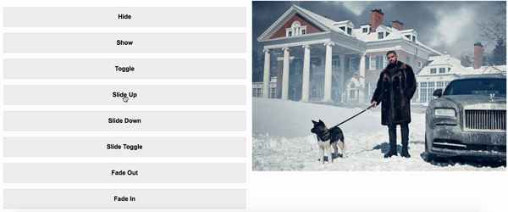
.slideUp() 上滑 & .slideDown() 下滑
$(".buttonSlideUp").click(function() {
$("img").slideUp();
});
Notes:
Move through these next 2 slides quickly, pointing at how we can use different actions to achieve different effects.

Slide 36
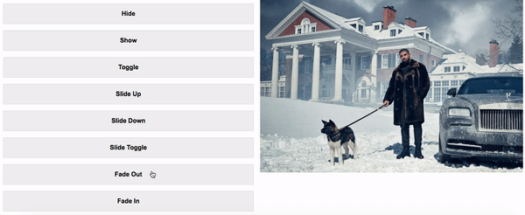
.fadeIn() 渐入 & .fadeOut() 渐出
$(".buttonFadeOut").click(function() {
$("img").fadeOut();
});
Notes:
Ask students what the difference between slide and fade is?

Slide 37
Animated jQuery Actions（动作）
No Animation | Slide | Fade
$("div").show() $("div").hide() $("div").toggle() 切换 | $("div").slideDown() $("div").slideUp() $("div").slideToggle() | $(“div”).fadeIn() $("div").fadeOut() $("div").fadeToggle()
Notes:
Have your students write down the information on this slide. Point out how each column has a way to show, a way to hide, and a way to toggle. Prompt the students with questions like, “If I want to show an element with a fade animation, which action should I use?”

Slide 38
.hide() 和.toggle() 有什么不同?

Slide 39
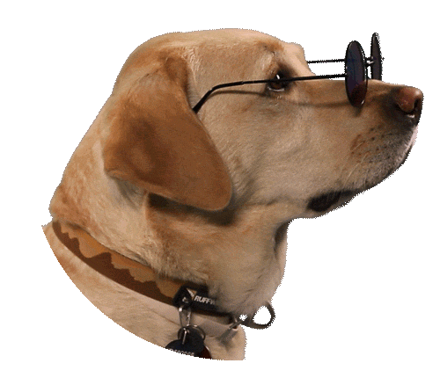
Working together, we’ll make the enormous dog appear and disappear with a .fade animation.
Start Here
Notes:
This is a crucial moment in the lesson, when we release control to the students and ask them, for the first time, to produce the code inside a click handler function from scratch.
You will type on the projector, but the class should be fully in control—only type exactly what they tell you, even if it’s a mistake. Have a co-teacher type while you call on individual students and continue leading the class.
If you have time, have the students modify the code so that the dog appears and disappears without a fade.

Slide 40
Create a jQuery Funhouse （欢乐屋）by filling in the click handler functions with appropriate jQuery actions.
mild medium spicy
https://popcode.org/?snapshot=cc72b480-da29-411d-bbf5-1889b9fe04d6
Notes:
Open up the starter code, and prompt students to describe (in general terms) what they need to do.

Slide 41
Extensions!
If you finish the jQuery funhouse early:
Add another feature to your funhouse page!
Be creative!

Slide 42
Which jQuery action would hide all <p> tags? 哪个可以隐藏所有的p元素？
$("p")._______;
.fadeIn()
.slideDown()
.slideUp()
.toggleOut()

Slide 43
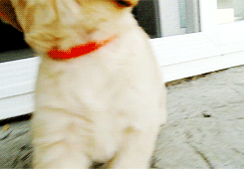
Paper
更新此代码以在单击按钮时隐藏图像。
$(" ").click(function() {
});
Notes:
Teacher Notes:
Coders should complete the Do Now in either Google classroom or on paper depending on your preference.

Slide 44
Open this popcode
更新此代码以在单击按钮时隐藏图像。
Computer
$(" ").click(function() {
});
Notes:
Teacher Notes:
Coders should complete the Do Now in either Google classroom or on paper depending on your preference.

Slide 45
use jQuery actions that
take one or more arguments（参数）, such as .text() 修改文本 and .css() 修改CSS.
Vocabulary: selector, arguments, action, .text(), .css()
Notes:
Coders should read aloud the objective.

Slide 46
Do Now Review
Which element do we click on?
Which element changed?
$(" ").click(function() {
$(" ").hide();
});
Notes:
Teacher Notes:

Slide 47
New jQuery!
我们可以使用jQuery更改页面上的CSS
变色狂魔
https://popcode.org/?snapshot=c8ceb0d5-b42d-43ec-8a0d-d05d5f90f86b
like this!
Notes:
Teacher Notes: just show them for now! we will do the typing later.
Ask: What changed?
We’ll see just how later in class.

Slide 48
Review CSS syntax:
Which part of this CSS is the:
Selector 选择器?
Property 属性?
Value 值?
body {
background-color: purple;
color: aqua;
}
Notes:
Teacher Notes: we'll see this pattern again in jQuery!

Slide 49
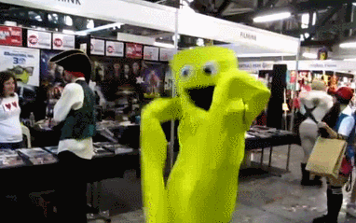
The .css() action
Let’s take a closer look into this Popcode.
Notes:
Teacher Notes: Click back into Popcode and change the background color to something else. Then show how you could use the same format to change font color and image size.
Don’t spend too much time on syntax and having students code this outloud. The next few slides break this down and there is a guided practice for that later.

Slide 50
The .css() action
$(".change").click(function)() {
$("body").css("color", "aqua");
});
.css action （修改CSS)
Notes:
Teacher Notes:
Where is our new .css() action? How does this look different from .hide()? What do you think .css does?

Slide 51
The .css() action
$(".change").click(function)() {
$("body").css("color", "aqua");
});
Arguments 参数
Which argument is the CSS property? Which is the value?
Notes:
Teacher Notes:
There are two arguments! Which argument is the CSS property? Which is the value? What would we change if we wanted to make the text pink instead? What if we wanted to change the background color?
Make sure to cover that arguments are additional information that we can give to an argument.

Slide 52
The .text() action
Let’s learn one more jQuery action that takes arguments:
$("button").click(function(){
$(".my-reply").text("Hello!");
});
.text action（修改文本）
What do you think this code will do?
Notes:
Teacher Notes:
Ask students about the technical term we just learned for an input like “Hello!” (arguments)

Slide 53
The .text() action
$("button").click(function(){
$(".my-reply").text("Hello!");
});
Argument
参数（改后的文本）
Notes:
Teacher Notes:
Where is our new .css() action? How does this look different from .hide()? What do you think .css does?

Slide 54
Multiple Actions（多个动作）
jQuery can perform more than one action on an event.
$("button").click(function(){
$("div").css("color", "yellow");
$("p").text("My text is yellow now!");
});
What do you think this code will do?
Notes:
Teacher Notes:

Slide 55
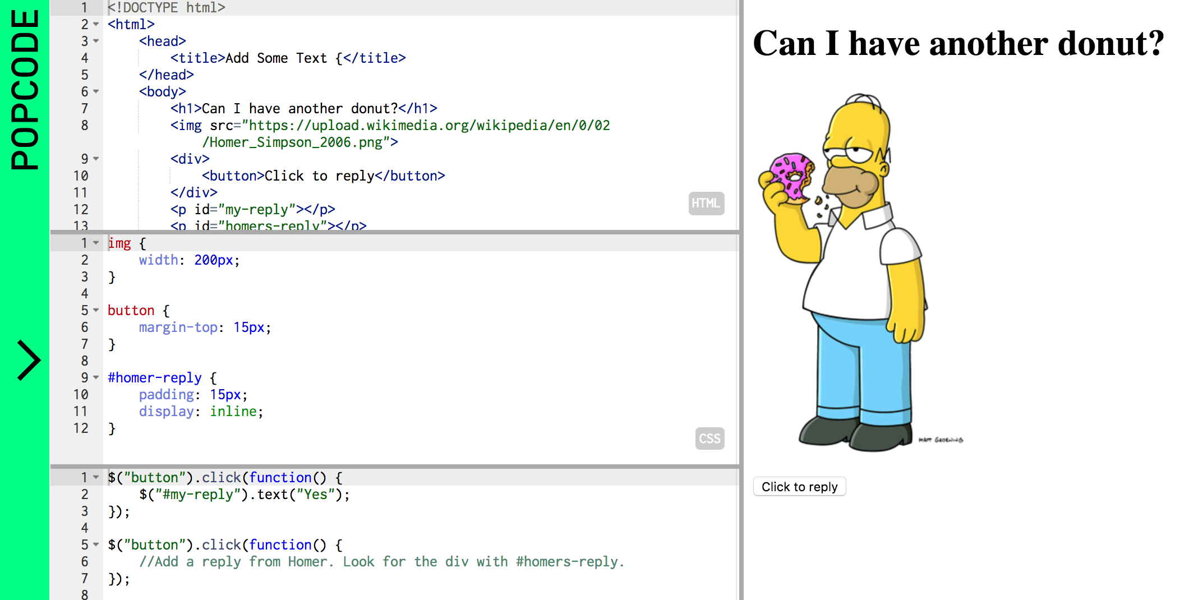
Let’s take a look at this in action
in Popcode
https://popcode.org/?snapshot=7d53f909-66a3-4441-8340-31d389326306
Notes:
Teacher Notes:
Point out the .homers-reply selector. Where is that on the page? What would happen if we didn’t have the empty <p> tag on the page?

Slide 56
In the Homer Popcode when the button is clicked:
Mild Medium Spicy
Respond with No and change Homer’s response to “Doh!”
Change the background color
Change the color of the header text
Make the photo bigger
https://popcode.org/?snapshot=d04583e4-555e-4084-a15d-a64d70adaac4
Notes:
Use this activity to have students explore the various 'justify-content' properties and get comfortable using flexbox.
Remind students that they can make their samples look however they want… they do not need to copy the examples on the slide above

Slide 57
Fill in the blank so that the page's background color will change to purple when the button is clicked.
$("button").click(function() { _______ });
$("body").css("button", "purple");
$("body").css("purple", "background-color");
$("button").css("background-color", "purple");
$("body").css("background-color", "purple");
Notes:
Teacher Notes:

Slide 58
Paper
On a piece of paper, write the jQuery code to:
Change the text “I love coding!” to “I love jQuery!”
Change the background color of the div with the class of rectangle to blue
Notes:
Teacher Notes:
Coders should complete the Do Now in either Google classroom or on paper depending on your preference.

Slide 59
Open this Popcode
Write the jQuery code to:
Change the text “I love coding!” to “I love jQuery!”
Change the background color of the div with the class of rectangle to blue
Computer
Notes:
Teacher Notes:
Coders should complete the Do Now in either Google classroom or on paper depending on your preference.

Slide 60
write event handlers that allow the page to respond when a user interacts with it
Vocabulary: event handler, dblclick, mouseenter, mouseleave, hover

Slide 61
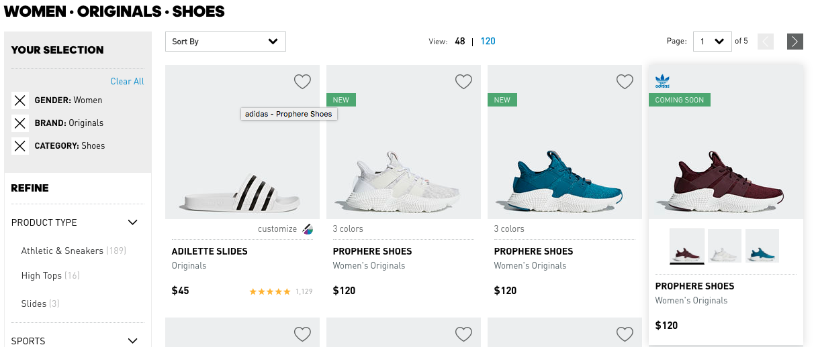
Why is this important?
Notes:
check out the adidas website for hover effect/click: http://www.adidas.com/us/women-shoes
Play around on the website to demonstrate different events: name clicks, hovers, etc and ask students what changes as you interact with the website in each of those ways. Be explicit about the events.

Slide 62
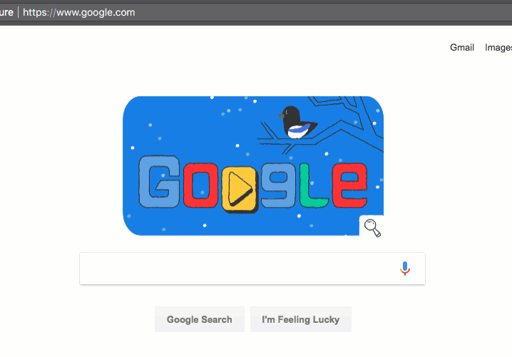
With the person next to you, list all the things you see the user doing to interact with the website.
Notes:
Mouse enter, mouse leave, (or hover), click, double-click, keypress

Slide 63
jQuery Events
An event is something that happens on a page.
Events can be:
Something the user does (clicking, typing, or moving the mouse over something)
Something that happens in the browser (the page finishes loading or the user scrolls down the page)
We create event handlers so that we can do something specifically when that event occurs.

Slide 64
jQuery Event（事件）
Events can be things the user does.
We’ve already seen one example of this before:
<button>Hide</button>
<img src="giraffe.jpg">
Plain English
When someone clicks the button element, hide the img element.
jQuery
$("button").click(function() {
$("img").hide();
});
User clicks

Slide 65
jQuery Events
But what about this?
<button>Hide</button>
<img src="giraffe.jpg">
Plain English
When someone double-clicks the button element,hide the img element.
jQuery
$("button").dblclick(function() {
$("img").hide();
});
User double clicks

Slide 66
jQuery Events
Or this?
<button>Hide</button>
<img src="giraffe.jpg">
Plain English
When someone moves their mouse over the button element, hide the img element.
.
jQuery
$("button").mouseenter(function() {
$("img").hide(); });
user moves their mouse over an element

Slide 67
jQuery Events
Or this?
<button>Hide</button>
<img src="giraffe.jpg">
Plain English
When someone moves their mouse off the button element, hide the img element.
.
jQuery
$("button").mouseleave(function() {
$("img").hide(); });
user moves their mouse off an element

Slide 68
How Event Handlers Work
event
Whenever this event occurs...
$("button").click(function() {
$("img").hide();
});

Slide 69
How Event Handlers Work
$("button").click(function() {
$("img").hide();
});
The code inside the curly brackets will run

Slide 70
Syntax review
Selector
Event
$("button").click(function() {
$("img").hide();
});
jQuery
Action

Slide 71
Event types
There are many types of events jQuery recognizes.
Here are a few:
Click （点击）
Dblclick （双击）
Mouseenter（鼠标进入）
Mouseleave（鼠标离开）
Hover（鼠标滑过）

Slide 72
Describe what the following code will do.
$(".target").click(function() {
$(".feedback").text("Click faster!");
});
$(".target").dblclick(function() {
$(".feedback").text("Perfect!");
});
Notes:
Mouse enter, mouse leave, (or hover), click, double-click, keypress

Slide 73
When the page first loads, will the image be shown or hidden? Why or why not?
$("button").dblclick(function() {
$("img").hide();
});
Notes:
This is a reminder to students that event handlers only run when the event occurs. Since the page just loaded, the user has not clicked anything yet, so the code inside the angle brackets will not run yet.

Slide 74
Is this an event handler or an action?
How do you know?
$("div").mouseenter(function() {
});

Slide 75
Let’s update our old Whack-A-Mole game to use other-events-a-mole to whack it.
Double-click
Mouse Enter
Mouse Leave

Slide 76
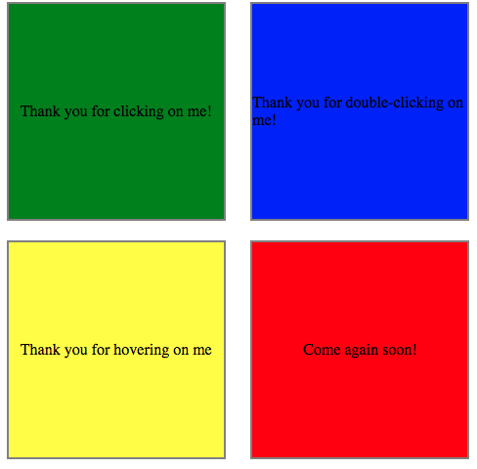
Let’s make our page interactive!
There are 4 boxes on the page. Let’s make each one react to a different event.
Open this mild medium spicy popcode to begin.

Slide 77
Fill in the blanks so that the text will only be shown when the user’s mouse is on the div (there are two different ways).
$("div") (function() {
$(".secret").text("Don’t tell anyone!");
});
$("div") (function() {
$(".secret").text("");
});
1.
2.
1. .mouseleave
2. .hover
b) 1. .mouseenter
2. .mouseleave
c) 1. .click
2. .dbclick
d) 1. .mouseleave
2. .mouseenter

Slide 78
练习
https://www.w3school.com.cn/jquery/index.asp

